Slide 1
Graph-based Testing Methodology for IoT Systems
Linghuan Hu
Prof. Eric Wong
University of Texas at Dallas

Slide 2
The Problem, Need and Industrial Relevance
Challenges of Testing IoT
IoT is a complicated system with heterogeneous devices and different software
Software behavior can be affected by the heterogeneous devices
IoT is dynamic, highly scalable
Very easy to have more than 1000 different devices in IoT
Many effective and mature software testing life cycles have been used in industry for testing traditional software
IoT has no such consensus
No evaluation metrics for IoT testing
Industry still uses the traditional software metrics for IoT testing

Slide 3
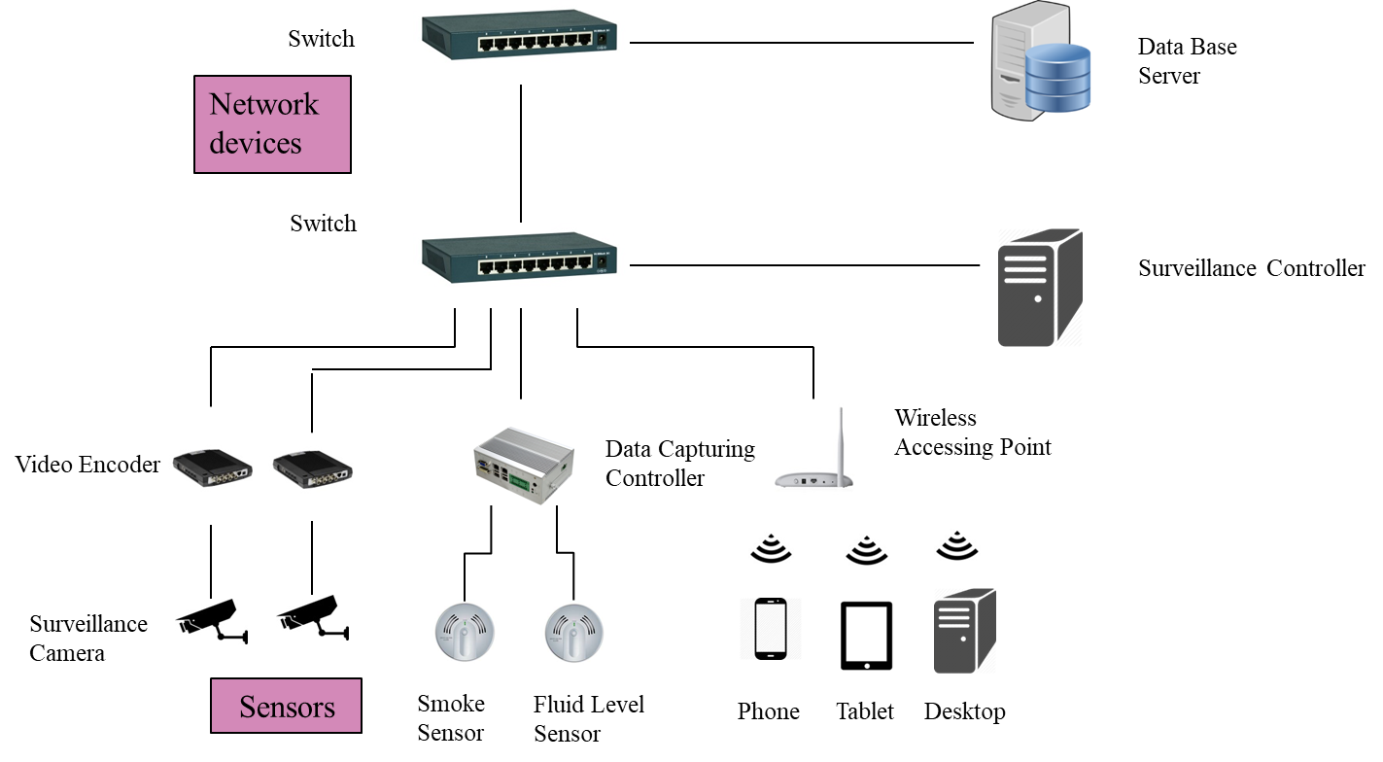
The Problem, Need and Industrial Relevance

Slide 4
Project Goals and Objectives
Provide a guidance on which set of paths and in what order you should test for a particular IoT system
Systematically and effectively test the entire system
Measure the test coverage based on the tested path of the system
Identify the paths that still require testing
Where should I start?
Did I miss anything?

Slide 5
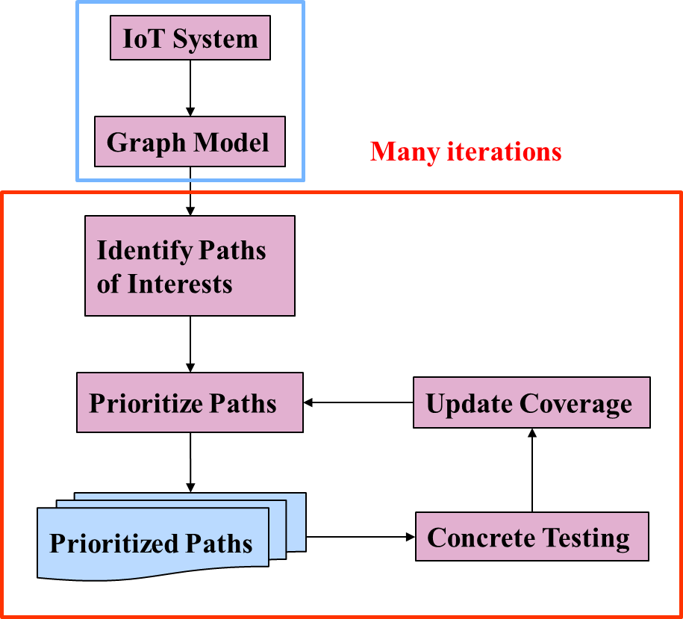
Research Methods and Novelty of Approach
Unlike other IoT testing approaches that only focus on the implementation level, we provide a testing methodology that
Provides an effective and efficient guidance
Integrates the low level testing techniques (e.g., combinatorial testing, symbolic testing, security testing, etc.)

Slide 6
Expected Outcomes and Deliverables
Develop and refine an effective IoT testing methodology, and integrate it with industry-level testing techniques
Modeling techniques
Path identification algorithms
Prioritization algorithms
Effective and efficient testing techniques
…
Apply developed methodology in industry-settings
Conduct empirical study using real-world systems
Revise the methodology based on feedback from industry
…

Slide 7
Project Timeframe
1 year project duration
First 7 months: modeling, algorithm, and testing techniques design
Last 5 months: empirical study, evaluation, and refinement

Slide 8
Impact of work proposed or already performed
Provide a helpful guidance on testing IoT systems
Measure the testing coverage for IoT systems

Slide 9
Questions?
Linghuan Hu <Linghuan.Hu@utdallas.edu>
Prof. Eric Wong <wew021000@utdallas.edu>

